Slide 1

6th Grade Math
Unit 7, Lesson 6 More Integer Addition Volume 2, pg. 29

Slide 2


Benchmark
MA.6.NSO.4.1
Apply and extend previous understandings of operations with whole numbers to add and subtract integers with procedural fluency.
volume 2, pg. 29

Slide 3
Integrated Mathematical Thinking and Reasoning Standards
MA.K12.MTR.3.1 Complete tasks with mathematical fluency.
MA.K12.MTR.5.1 Use patterns and structure to help understand and connect mathematical concepts.
volume 2, pg. 29

Slide 4

Learning Target
I can add integers with procedural fluency.
volume 2, pg. 29

Slide 5

Warm-Up
volume 2, pg. 30

Slide 6


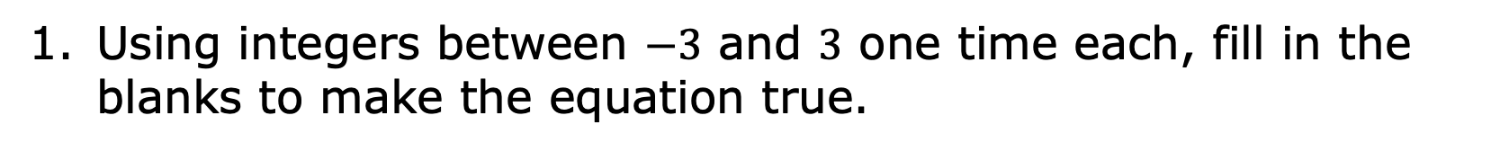
7.6.1 Warm-Up: True Equations
Using integers between $−3$ and $3$ one time each, fill in the blanks to make the equation true.
$$+$$
$$=$$
volume 2, pg. 30

Slide 7

Activity
volume 2, pg. 30

Slide 8




7.6.2 Activity: Integer Wars
Set Up:
Remove all jokers and face cards (Kings, Queens, and Jacks) from the deck.
With your partner, determine who is the dealer. The dealer deals the entire deck of cards to each player, face down.
Rules:
The black cards (Spades and Clubs ) represent positive values.
The red cards (Diamonds and Hearts ) represent negative values.
Aces represent either 1 or (_^−)1, while the other cards represent the positive or negative value indicated on the card.
volume 2, pg. 30

Slide 9
How to Play:
To begin, each player will flip over one card from their deck and place it in the center.
The first player to figure out the sum of the two integers keeps both cards and adds them to the bottom of their stack.
NOTE: If a player says an incorrect sum, the other player responds for a chance to win the hand before the first player can change their answer.
Repeat this process until time is called or until all of the cards have been used.
volume 2, pg. 30

Slide 10

Guided Practice
volume 2, pg. 31

Slide 11

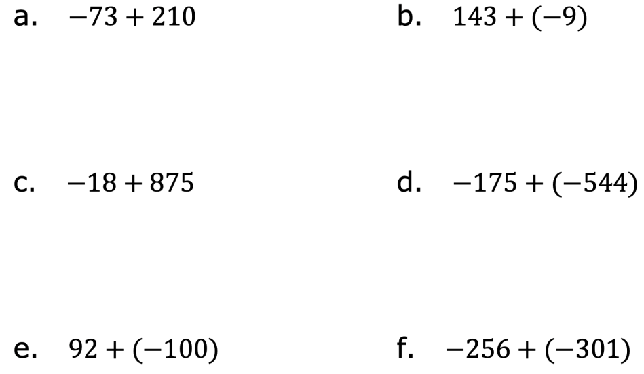
7.6.3 Guided Practice: Fluency with Adding Integers
Find each sum.
volume 2, pg. 31

Slide 12
Write two tips to share with someone who is just learning how to add integers.
volume 2, pg. 31

Slide 13

Your Turn
volume 2, pg. 31

Slide 14

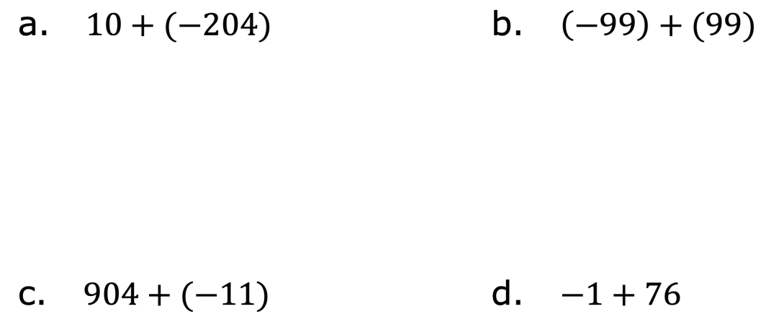
7.6.4 Your Turn!
Find each sum.
volume 2, pg. 31

Slide 15
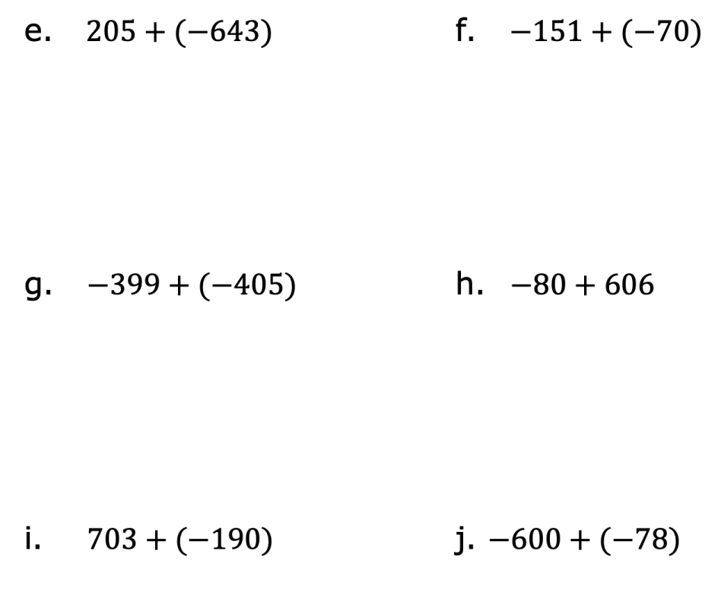
volume 2, pg. 31

Slide 16

Wrap-Up
volume 2, pg. 32

Slide 17

7.6.5 Wrap-Up: Ticket Out the Door
Find each sum.
$808+(−547)$
volume 2, pg. 32

Slide 18
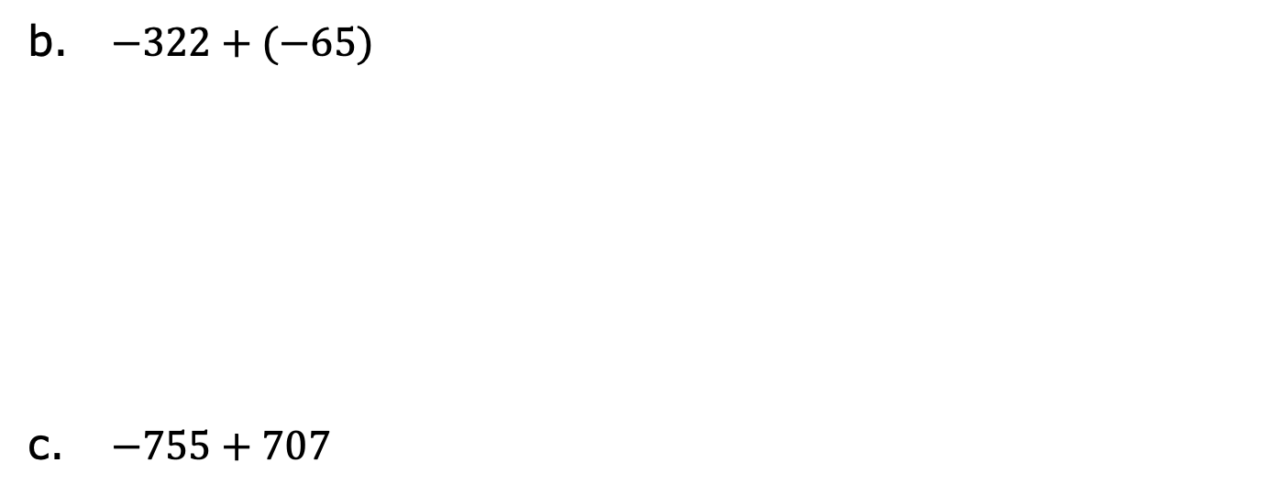
$−322+(−65)$
$−755+707$
volume 2, pg. 32

